Slide 1

VAST 2019 GRAND CHALLENGE Voice from the People

Slide 2
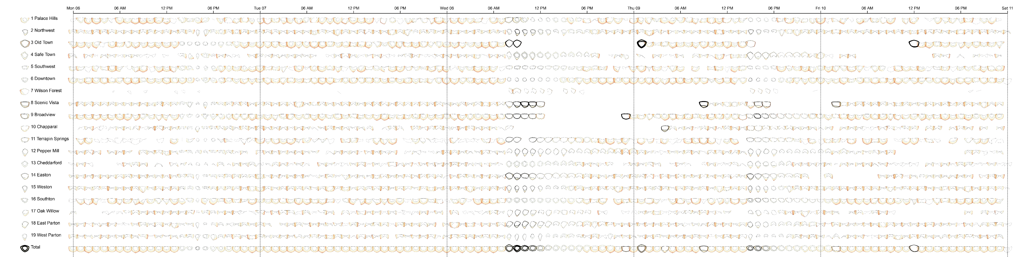
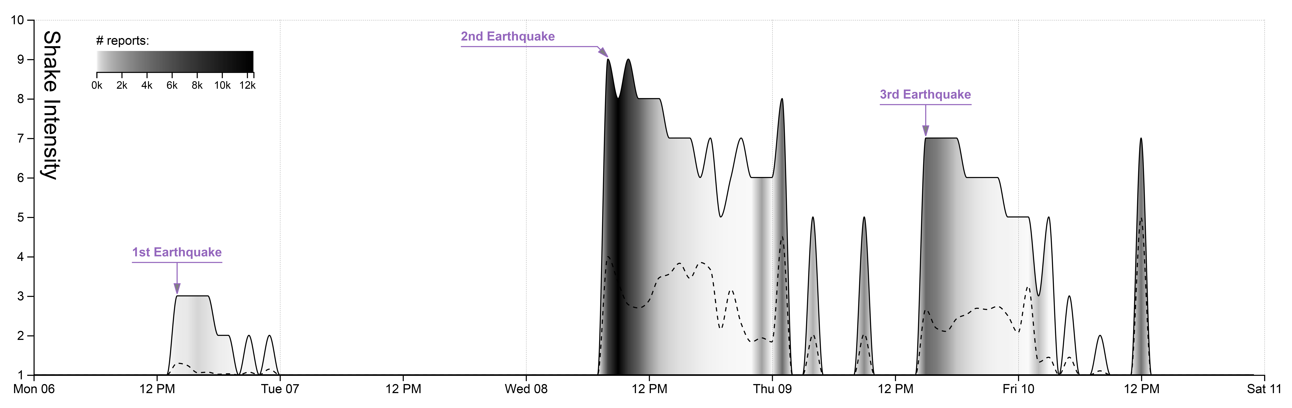

Shake insensitive aggregated by hour
Notes:
Let start with the simplest graph. We have the shake insensitive report by citizens via mobile app. The number of report is encoded by color. The lighter color have a smaller number of reports than the darker. Now we know when earthquakes happened but where and how uncertain of this report need some extra information.

Slide 3
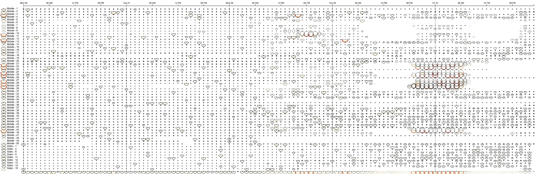

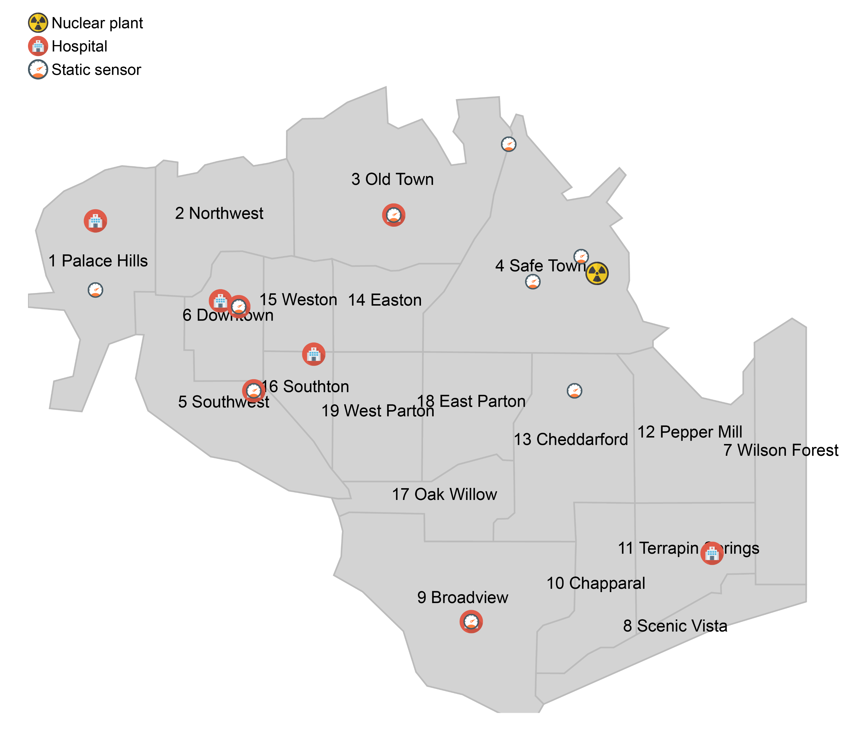

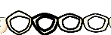
Old Town
Old Town
Power, Medical
Sewer, Power, Road
Road, Sewer, Power
Scenic Vista
Scenic Vista
Broadview
Chapparal
Sewer, Power, Road
Sewer, Power, Road
Power
Global Earthquake
Local Earthquake
Notes:
With visualization we introduced in mini challenge 1. we can confirm the uncertainty information like those charts (have large gap of quantile 1 and quantile 3, also, the stroke of those chart is thin which mean there are a few report at that time).
And that story is different with another charts. Those 4 charts have the smaller gap and thicker stroke, therefore, the accuracy of provided information is very high.
Now we can confirm 3 specific time of earthquake happened in global scale.
And identify the local event and emergency reports with damaged larger than 7.5

Slide 4
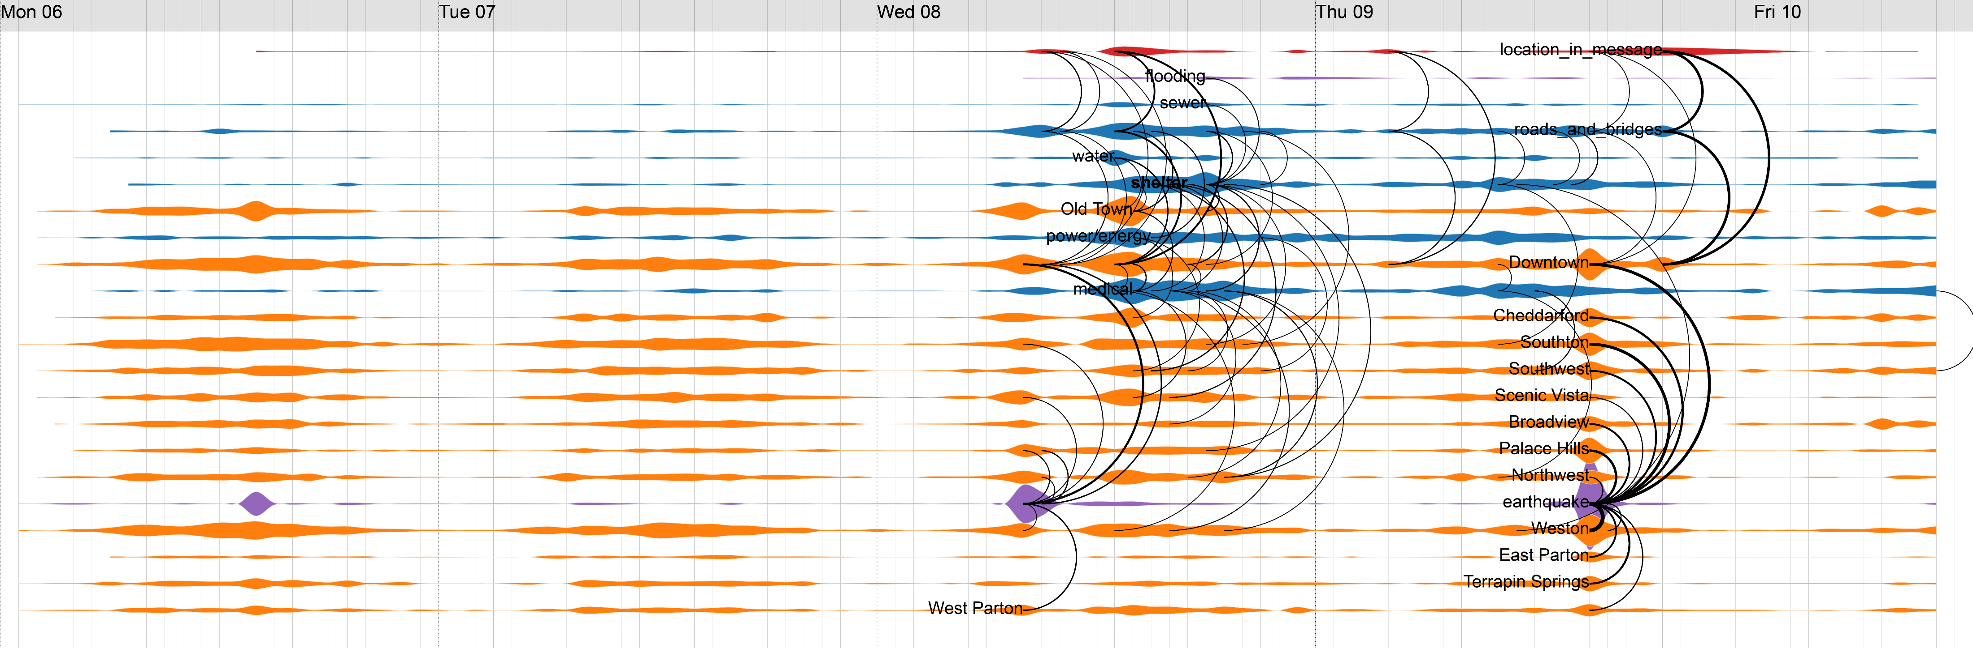
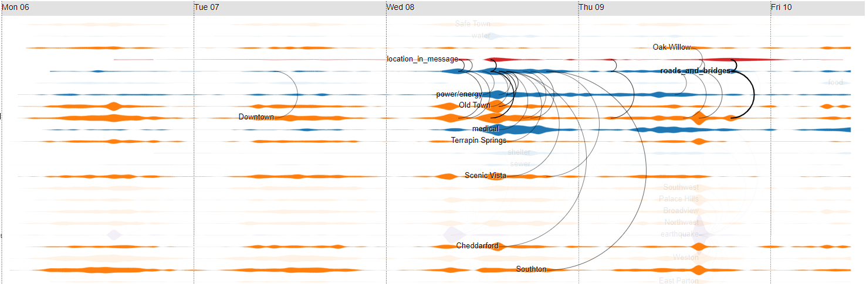
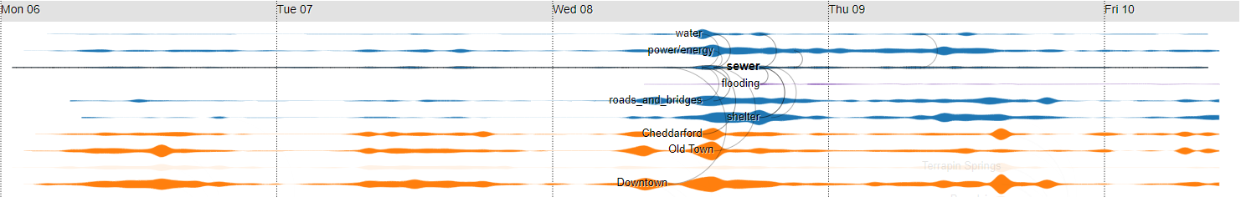
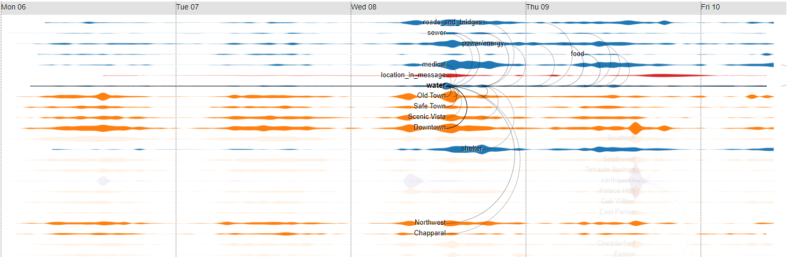
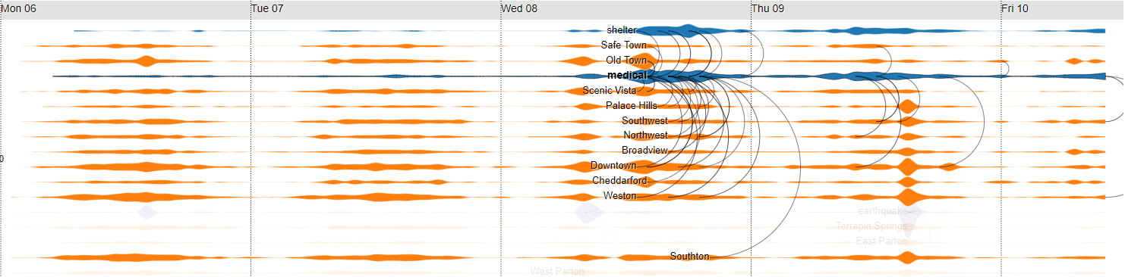
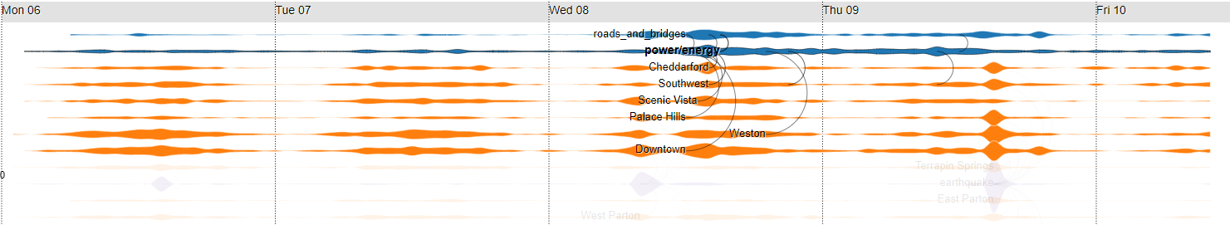
Mobile sensor 9
Mobile sensor 10
Mobile sensor 20
a
b
c
d
e
Road and bridge
Re-open all route except
Wilson Forest highway &
12th of July Bridge
Close all routes
Re-open Wilson Forest highway & Magritte Bridge
Reopen other routes & traffic jam at Magritte Bridge
Sewer
flooding
Water
Contaminated Water
Medical
Asking for rescue team
Shelter demand
Power
Notes:
Abnormal radian measurement of mobile sensor 10 can be the result of the Major earthquake or the result of high demand of medical in Old Town.

Slide 5
Contaminated Water map
mc3 – All area
Shelter: Shelter demand
mc3 – All area
mc3 – All area
Old Town
Medical: Asking for rescue team
Flooding
Sewer, Power, Road
mc3 – part of city
Sewer & Water: Contaminated Water
mc3 – routes to outside
mc3 – routes to outside
Roads & Bridge: Reopen other routes & traffic jam at Magritte Bridge
Roads & Bridge: Re-open all route except
Wilson Forest highway &
12th of July Bridge
mc3 – routes to outside
mc1: Scenic Vista
Roads & Bridge : Close all routes
mc1: Old Town
Sewer, Power, Road
Power, Medical
mc3 – routes to outside
mc1: Broadview
Roads & Bridge: Re-open all route except
Wilson Forest highway &
12th of July Bridge
Sewer, Power, Road
Scenic Vista
Chapparal
Road, Sewer, Power
Power
Global Earthquake
Social event
Old Town
Scenic Vista
Local Earthquake
Safe Town
Wilson Forest
Radian Event
a
b
c
d
e
Road and bridge
Re-open all route except
Wilson Forest highway &
12th of July Bridge
Close all routes
Re-open Wilson Forest highway & Magritte Bridge
Reopen other routes & traffic jam at Magritte Bridge
Reopen other routes & traffic jam at Magritte Bridge
Sewer
flooding
Water
Contaminated Water
Medical
Asking for rescue team
Shelter demand
Power
Notes:
Medical event and radian event

Slide 6
Thank you for your attention

